Slide 1
Political Economy of Bangladesh Historical Perspective
.

Slide 2
Political Economy:
A Historical Perspective
Broadly Divided in 7 Periods
1. Indus Valley Civilization (3300BC –1700BC)
2. Aryans Invasion (1700BC – 322BC)
3. Maurya Dynasty (322BC – 185BC)
4. Gupta and Pala Period (320AD – 1120AD)
5. Muslim Rule (1175AD – 1760AD)
6. European Rule (1760AD – 1947AD)
7. Pakistan Period (1947AD – 1971AD)
8. Bangladesh period (1971 AD - )

Slide 3
Indus Valley Civilization
Harrapa (Punjab region) and Mohenjo-Daro (mouth of Indus River) civilization was developed by original indians.
Discovery from ruins of Harappa and Mohenjodaro testifies a high level of social and cultural development in a Bronze Age type civilization until 1500 B.C,
Harappa and Mohenjo-daro were surrounded by smaller cities, towns, and villages. Mohenjo-daro was spread over 500 miles along the river valley
Harappan civilization was dependent on agriculture and grew a variety of crops. Trade was limited with Egypt and Mesopotamia.
Harappan achievements included writing system, city planning and art.
Perhaps natural disasters caused the civilization to collapse.

Slide 4
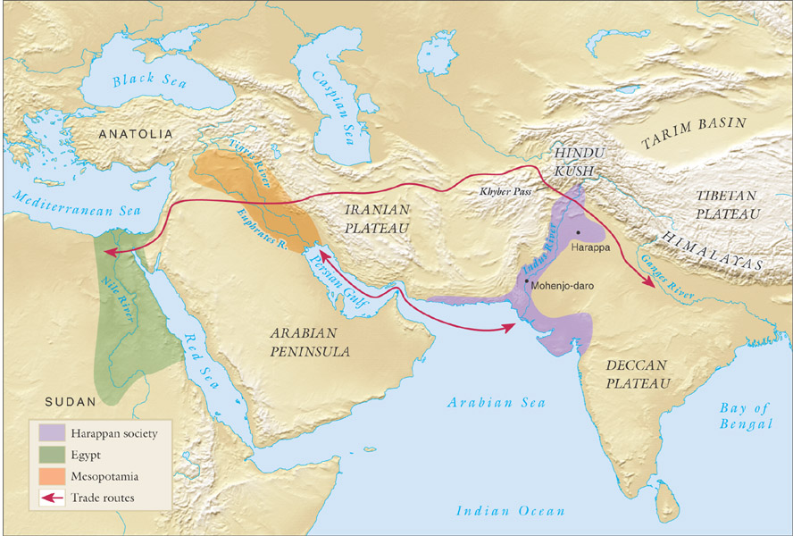

Slide 5
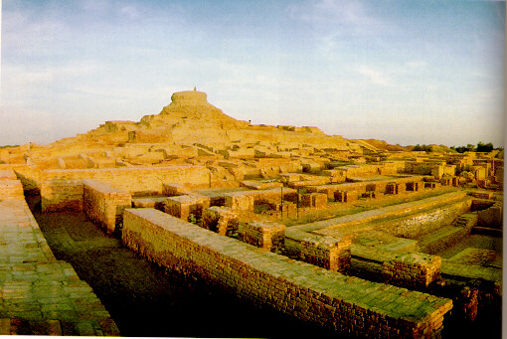
Mohenjo-daro view

Slide 6

Harappan achievements
Developed India’s first writing system
Scholars cannot read this system.
Must rely on other clues to study Harappan society
Writing System
Skilled engineers
Towering fortresses were built near each city.
Streets were lined with market stalls and houses.
Built extensive sewer systems
City Planning
Artistic
Achievements
Skilled artisans
Sturdy pottery vessels, jewelry, and ivory objects

Slide 7
Aryan Invasion
The Aryans, Indo-Europeans settled in the thick jungles of south of the Ganges.
Aryans were tall, blue-eyed, fair-skinned and restless people fond of fighting, drinking, chariot racing, gambling and chasing women.
Aryans settles down in Afghanistan, Orissa and the deltaic region of the Ganges in early 1700s BC.
Economy: Pastoral and Agrarian
Indigenous people known as Dravidians started fighting with Aryans.
Emergence of kingdom, the king and the army gave birth to a non-producing group.
Apart from war and farming, some families specialized in crafts men, ship manufacturing, spinning and weaving of cotton, etc.

Slide 8
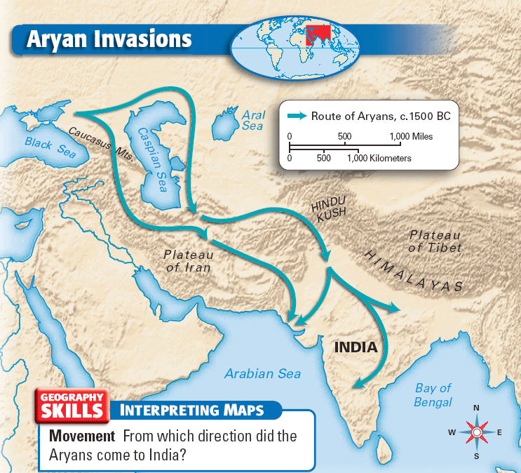

Slide 9
Ayran invasion changed India’s Society
Government and Society
Nomads eventually settled in villages and engaged in farming
People lived in small community based on family ties
Villages , a few communities, were governed by Rajas.
Groups often fought each other
People did not write but memorized poems that were important
Social Division
Divided Indian society into groups / caste based on a person’s birth or occupation
People could change caste on rare occasions.
Untouchables were considered unclean and were the outcasts of society.
Hindu Religion expanded.

Slide 10
Maurya Dynasty
Aryans rule was ended may be due to internal clash from Khotriaya and Maurya came in ruling ( 322 B.C -185 B.C).
Production forces: Plough and bullock remained same but the distribution of wealth has changed.
Unit of administration was called Janapada. Lands were divided into two types - Rashtra land and Sita land.
Rashtra tax was imposed on Rastra land which was one-sixth of the harvest.
Sita land was under direct supervision of the local authority.
Local authority in collecting taxes was more on Sita lands.
Taxes on Sita lands were fixed at between one-third and one-fifth of the produce.

Slide 11
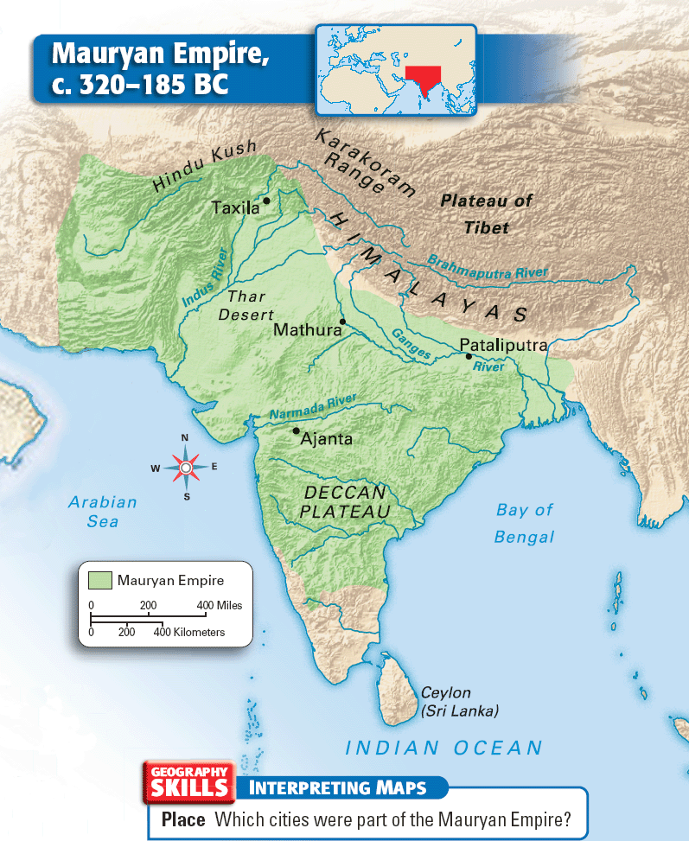

Slide 12
Settlement unit, which was called village, was formed with a population of 100 to 500 peasants.
The Sudra and other lower class people were mainly forced to settle in those Sita lands.
Share cropping system and Hired labor system was introduced in this region during that time may be due to averse tax burden.
Rural agrarian economy was almost self-sufficient, farming was the main activity.
Education and Intellectual movements was higher. The World's first university was established in India (Nalanda)
Non-violence movement was promoted along with Buddhism.
From the killing of last Mauryan ruler, India fell into disunity and South Asia fragmented into regional powers.

Slide 13
Gupta and Pala Empire
After the decline of Mauryans, Gupta rulers from central Asia rose to power
Gupta empire prospered mainly from mining, farming and trade.
It was the era of the most advanced civilization, higher education, foreign trade and an overall happy life. It is called the Golden Age of India.
The Gupta kingdom was unified but it declined due to invasion of the White Huns.
After the death of the last Gupta ruler in 570 AD, the empire declined and broke off. The north India broke into a number of separate Hindu kingdoms.
Subsequently, Pala empire came in power and ruled India,
The Pala empire was unique because of the trade with China reached its height during this era.
However, the empire was not really unified again until coming of the Muslims in power.

Slide 14
Gupta Achievements
500 healing
plants identified
1000 diseases
classified
Printed
medicinal guides
Kalidasa
Plastic
Surgery
Medicine
Literature
Inoculations
Gupta
India
C-sections
performed
Solar
Calendar
Mathematics
Astronomy
Decimal
System
The earth
is round
PI = 3.1416
Concept
of Zero

Slide 15
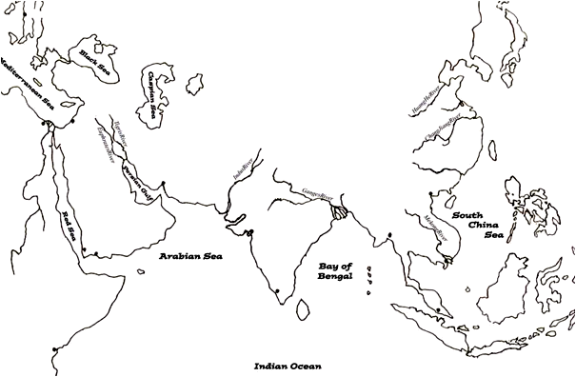
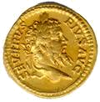
Extensive Trade: Gupta period
spices
silks
cotton goods
rice & wheat
spices
horses
gold & ivory
gold & ivory
cotton goods

Slide 16
Muslim Rule – (Turks and Mughals)
The Turks from Central Asia invaded India and ruled from 1175 to 1340 AD who were more interested in wealth rather than politics.
Alauddin Khilji’s (1296-1316) time, though the land revenue was fixed at half of the produce, the land administrators could levy Iqtas- also one kind of land revenue which exploited the peasants more harshly.
The Turkishs were soon replaced by the Mughals. Babar’s conquest of India in 1526 started the Mughal rule which was consolidated remarkably by Akbar in 1556-1605.
Though the Indian’s had a comfortable living standard, the income gap between the rich and the poor created scarcity and even famine during the Mughal period.

Slide 17
Introduced Jaigirdari system, similar to Iqta system. Administrators known as Subahdars, Mansabdars, Jagirdars and Zemindars were empowered to levy land revenue.
During Akbar’s time, land classified in terms of soil condition.
Land revenue fixed at one-third of the produce could be paid either in cash or in kind. Tenancy rights were granted to the peasants.
Standard of living was very low, in some cases near to starvation levels.
Muslim religion spreader but Hindu-Muslim live side by side.
The Muslim successors were weak and corrupted due to extravagant expenditures and The Europeans came in power.

Slide 18
European Rule
Italians and Portuguese made several attempts to find an easy route to India that will avoid the hostile route through northern part of India.
Subsequent to Vasco Da Gama’s arrival in India in 1498, the Portuguese fought and established their dominance and appointed Portuguese Governor in India.
Due to the incompetent administration, the Portuguese power began to decline and the Dutch rose to power who established the Dutch East India Company but their dominancy declined under the pressure of the English.
The British navy was much superior to the Dutch and the English controlled the Dutch possessions in India.
The British reduced money circulation drastically, closed commercial centers and forced industries out of operation for their own business.
The British influence inspired western education and created a new educated class and prominent Indians established commercial relationships with foreigners

Slide 19

The British Rule
The British exploited India in many ways, like:–
  Widespread looting – created even terrible famine– one-third of the total population died in 1769 of starvation and this famine was not caused by natural digesters but by hoarding of food grains and controlling production system
  New tax system - introduces tax at one-sixth of the estimated production, does mean that revenue burden was not same, because one-sixth of the expected produce may not be equal to the one-sixth of the actual produce.
  Divide and Oppressive regulation - Divide and Rule policy (Hindu and Muslim) of the British was instrumental for the division of India and the consequent breakdown of communal harmony to stop any local movement.

Slide 20
Widespread Looting : Alternative ways of exploitations
- Beside the permanent settlement, the British also established some exploitative institution to collect agricultural surplus through collecting land revenue, purchasing raw materials for British industries at lower prices, importing British products to India at higher prices.
Even after the establishment of improved transport like railways, India experienced 16 famines in 20 years.
- Inaction of the government, export of food grains even in years of apparent scarcity, lack of irrigation facilities and reluctance of the government to improve agriculture were the main causes of famine.

Slide 21
New Tax System: a new dimension to exploitation
The Permanent Settlement Act was enacted by Lord Cornwallis in 1793 lead to a radical change in the existing land–man relations.
New class of Zemindars emerged with the permanent proprietary rights.
Apart from being loyal to the locality, Zemindars played a vital role in sustaining colonial rule and sucking out wealth without any head to the national economy.
Peasants, previously owner of lands, became tenants and they completely depended on the mercy of the Zemindars.
Peasants became slave!!!

Slide 22
Oppressive regulation: Divide and rule policy
Divide and Rule policy (Hindu and Muslim) of the British was instrumental to regulate the local community.
Several peasant movements triggered due to oppressive rules Fueled much to the Freedom Movement, but could not be achieved due to lack of proper leadership at that time.
Railroads were established by the British ruler for their own sake with a purpose to facilitate the movement of the British army to suppress any activities by the locals against the British rule and to assist shipment of raw materials from various parts of India to Britain.
British capitalism penetrated mainly into indigo, tea and jute. British made the farmers bound to cultivate those crops.
Muslim Zemindars, who were small in number, but equally exploited and oppressed the peasants like their Hindu counterparts.
- Polarized on the basis of religion, there was a demand for a separate state for the Muslims in India.

Slide 23
Pakistan Period (1947 -1971)
Pakistan become free and independent country in 1947 and Bangladesh was a province of Pakistan.
Pakistan's history from 1947 to 1971 was marked by political instability and economic difficulties.
East Pakistanis felt exploited by the West Pakistan because of the dominated central government.
There was a lot of difference between West and East Pakistan like (i) Language, (ii) Economic oppression by the West, (iii) People in East was soft hearted as living in plain land, and (iv) People of the West thought themselves as pure Muslim.
However, jute industries grows in Bangladesh with the help of the government, a number of jute mills including Adamjee was established in 1950s.
Language Movement (1948-1952), Six point movement (1966) were important events and genesis for the birth of Bangladesh.

Slide 24
Bangladesh period (1971 -)
Bangladesh has a steady economic growth (5% - 6 %) since 1990s
Decline in population growth (2.5% in 1980s to 1.3% in 2010)
Primary education enrollment from 72% in 1980 to 98% in 2010
Infant mortality from 145 in 1970 to 59 in 2009 per 1000 live births
Population in poverty reduced from 59% - 32% during 1990 - 2010
Food security markedly increased – near self-sufficiency in rice production. Consumption of meat, fish, fruit, vegetables increased
Democracy is near to be established in the society and country.
Not only that, Bangladesh has made a remarkable progress in corruption!!! More than bribery - abuse of power for private gain; power in & outside the government are the barrier for development.

